Slide 1
Petrol Pump Development Project
Presented by Ashwini Bagde

Slide 2
Table of contents
Introduction
Project Goals and Objectives
Project Need and Justification
SDLC Cycle
Sprint Planning Overview
Cost Estimation Breakdown
Conclusion

Slide 3
Introduction
The project aims to develop a state-of-the-art petrol pump with modern technology and efficient infrastructure.
The project will follow a structured approach using agile methodology to complete construction tasks within a planned timeline.
The ultimate goal is to provide a superior customer experience with seamless fuel management, secure payment processing, and a safe environment for all users.

Slide 4
Project Goals and Objectives
Fuel Inventory Management
Implement fuel dispensers and automated gauging systems.
Enhance inventory management processes to reduce errors.
Payment Processing
Establish advanced point-of-sale systems that support multiple payment methods.
Ensure quick and seamless payment processing to enhance customer satisfaction.
Safety Compliance
Integrate comprehensive safety measures, including fire suppression and surveillance systems.
Conduct regular safety inspections and testing to maintain a secure environment for customers and staff.
Design Aesthetics
Create a visually appealing forecourt and facilities.
Incorporate functional design elements to ensure convenience and accessibility for all users.

Slide 5
Project Need and Justification
Rising Fuel Demand
Manual Process Challenges
Modern Tech Advantages
There is a growing need for reliable and efficient fuel services to meet consumer expectations.
The increase in vehicle usage and transportation activities drives the demand for modern petrol stations.
Manual processes lead to errors and inefficiencies, resulting in customer dissatisfaction.
These challenges hinder operational efficiency and can compromise safety standards.
Integrating advanced technology enhances fuel inventory management and payment processing.
Modern infrastructure improves safety compliance and provides a superior customer experience.

Slide 6







SDLC Cycle
Planning
Requirement
Analysis
Design
Implementation
Testing
Deployment
Maintenance and Support

Slide 7
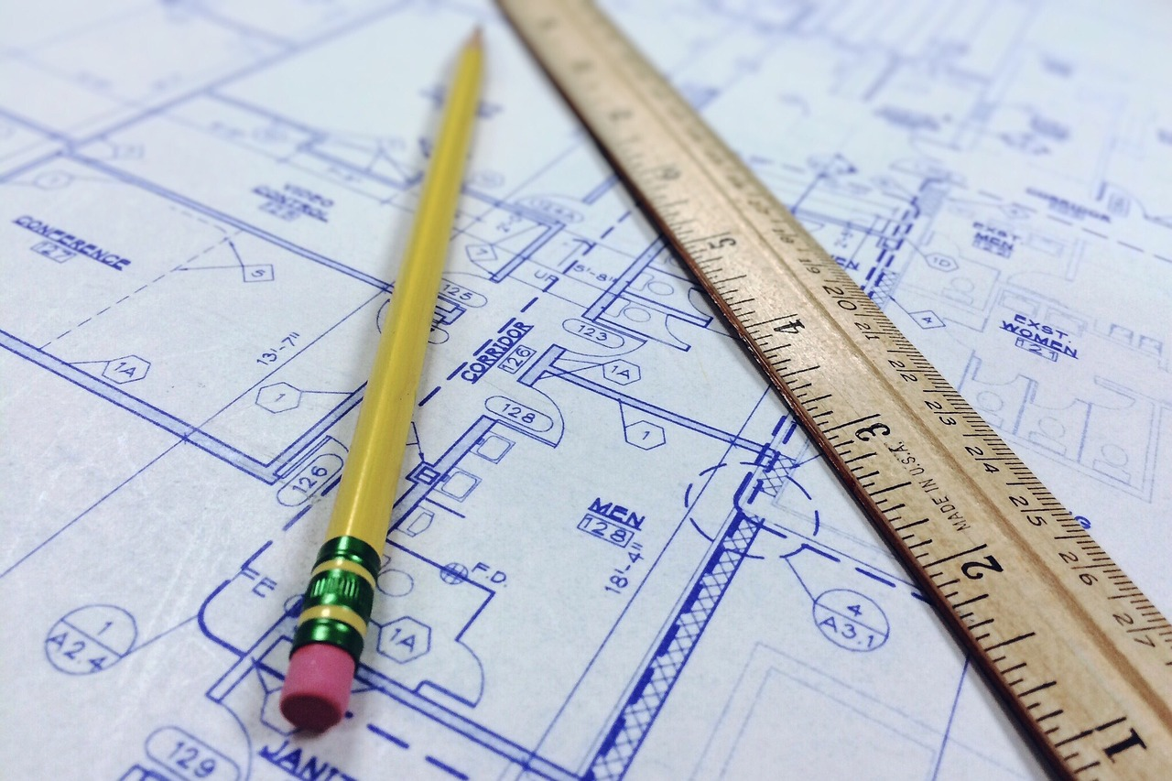
Sprint Planning Overview
Sprint 1: Initiation and Site Preparation
Conduct Site Survey
Obtain Necessary Permits and Approvals
Clear and Prepare Site
Install Underground Storage Tanks (USTs)
Sprint 2: Foundation and Infrastructure Setup
Construct Fuel Dispensers
Lay Fuel Pipes and Connections
Construct Office Building
Install POS Systems and Payment Terminals

Slide 8
Sprint 3: Canopy, Forecourt, and Safety Systems
Construct Canopy and Forecourt
Install CCTV and Surveillance Systems
Implement Fire Suppression Systems
Sprint 4: Backup Systems and Containment
Set Up Backup Power Systems (UPS)
Install Spill Containment Systems
Construct Driveways and Parking Areas
Sprint 5: Digital Signage and Aesthetic Improvements
Install Digital Signage
Landscaping and Aesthetic Improvements

Slide 9
Sprint 6: Quality Inspection and Testing
Conduct Quality Inspection and Testing
Finalize and Clean Up Site
Sprint 7: Integration and Training
Conduct Training for Staff on New Facilities
Integrate Fuel Management System with Infrastructure
Sprint 8: Final Approvals and Launch
Obtain Final Regulatory Approval
Conduct Soft Launch and Initial Operations

Slide 10
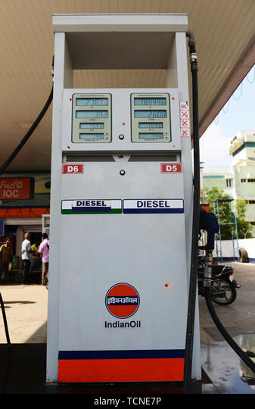
Cost Estimation Breakdown
Land Acquisition
Estimated cost ranges from ₹40,00,000 to ₹60,00,000 for purchasing suitable land.
This is a crucial investment for developing the petrol pump.
Construction Costs
Total estimated construction costs ranges from ₹50,00,000 to ₹90,00,000.
This includes the building structure, fuel tank installation, canopy and pump installation, and pavement.
Equipment Costs
Estimated cost for equipment ranges from ₹25,00,000 to ₹32,00,000.
This covers the purchase and installation of fuel dispensers and point of sale systems.
Regulatory Costs
Regulatory and permitting costs are estimated between ₹8,00,000 and ₹15,00,000.
This includes expenses for environmental assessments and necessary permits.

Slide 11
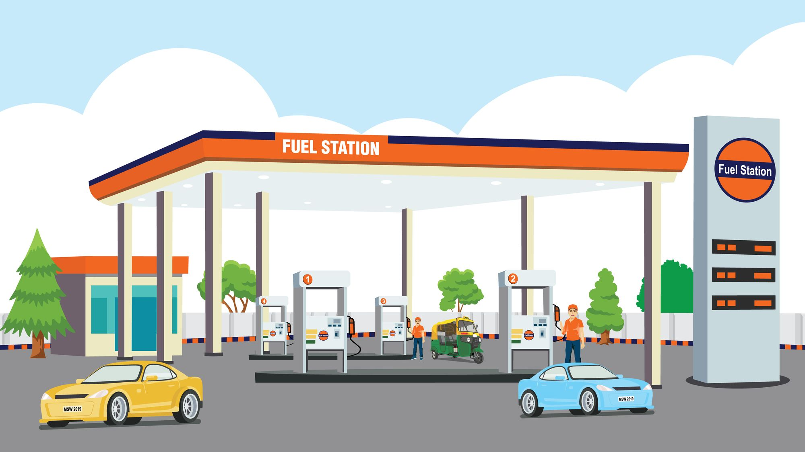
Operational Costs
Initial operational costs are estimated to be between ₹10,00,000 and ₹15,00,000.
This includes the purchase of initial inventory for the petrol pump.
Marketing and Branding Costs
Initial marketing, brand signage, and promotional costs are estimated between ₹2,00,000 and ₹5,00,000.
Contingency Fund
Contingency Fund ranges from ₹14,00,000 to ₹22,00,000.
A buffer for unexpected costs, typically 10-15% of total project costs.

Slide 12
Conclusion
The Development of the Petrol Pump is a comprehensive project that involves meticulous planning, modern technology integration, and adherence to safety standards.
By following a structured sprint plan and leveraging agile methodology, the project aims to complete construction tasks efficiently within the planned timeline.
The end result will be a state-of-the-art petrol pump that offers efficient fuel management, seamless payment processing, enhanced safety, and a superior customer experience.
This project will set a new standard in petrol pump operations and serve as a model for future developments in the industry.

